Slide 1

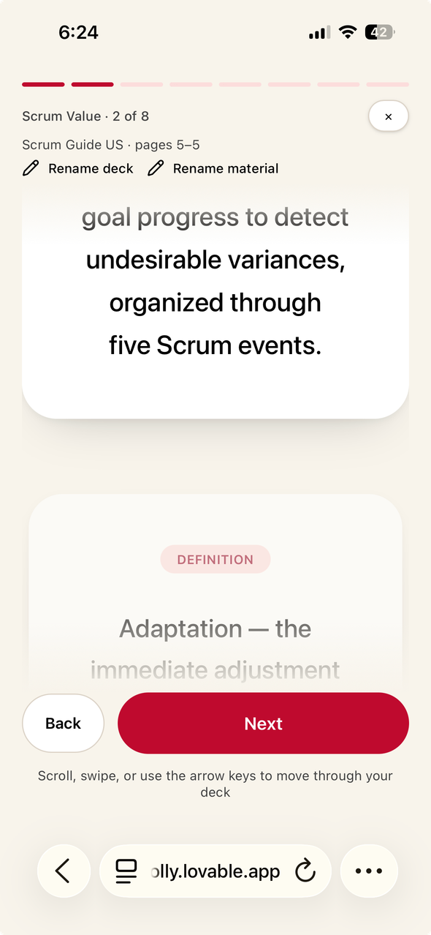

PRESENTED BY:
MIN
PAVITRA
SEPTEMBER 11, 2026
Scrolly
Smart Doomscrolling
SDG-4 QUALITY EDUCATION | AI powered learning

Slide 2

Scrolly
Long textbooks, articles, and
lecture notes can be difficult and overwhelming to study.
Students often lose focus when dealing with large blocks of information.
What is the problem?
Important concepts can be
hard to understand, remember,
and revise.

Slide 3
Scrolly
What if studying worked like scrolling?
As You Love Doomscrolling...

Slide 4
Our Idea
Scrolly
Use a scrolling format that feels familiar and engaging
Turn long study material into short, easy-to-understand cards
Add quick quizzes with instant feedback to make learning active
Support diverse languages that makes learning more comfortable

Slide 5
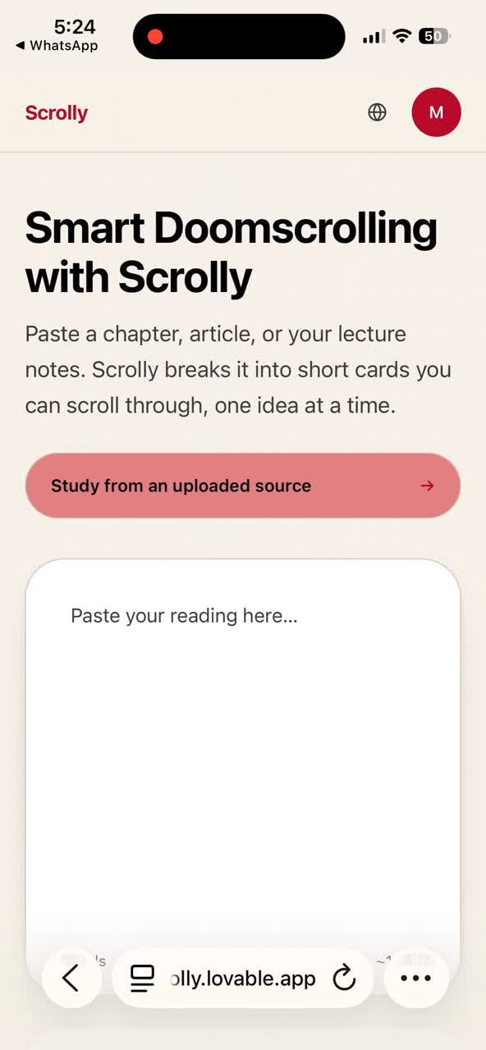
Scrolly
How Scrolly Works?
simple, we use the Paste. Choose. Scroll. Learn method

Slide 6
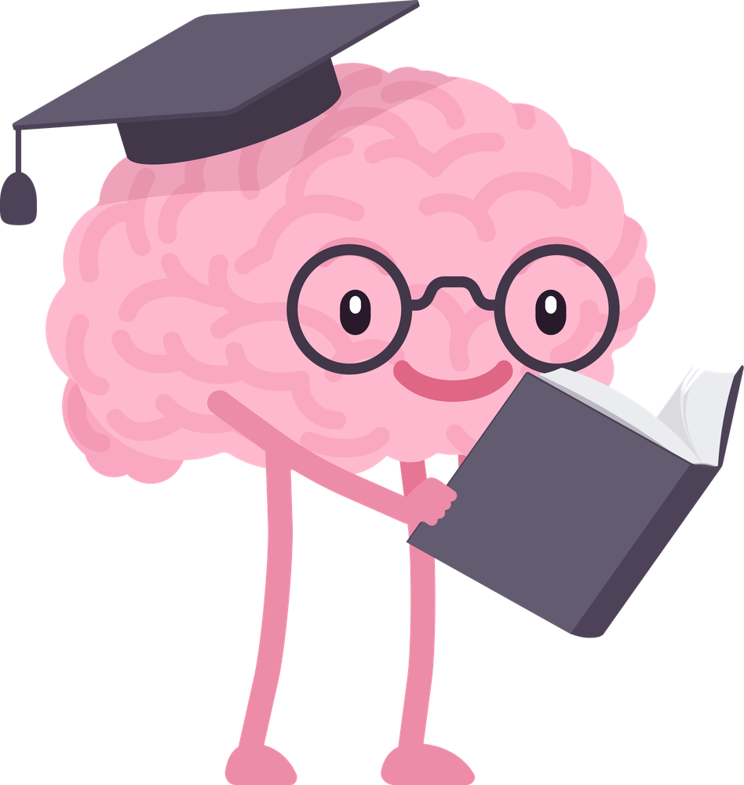

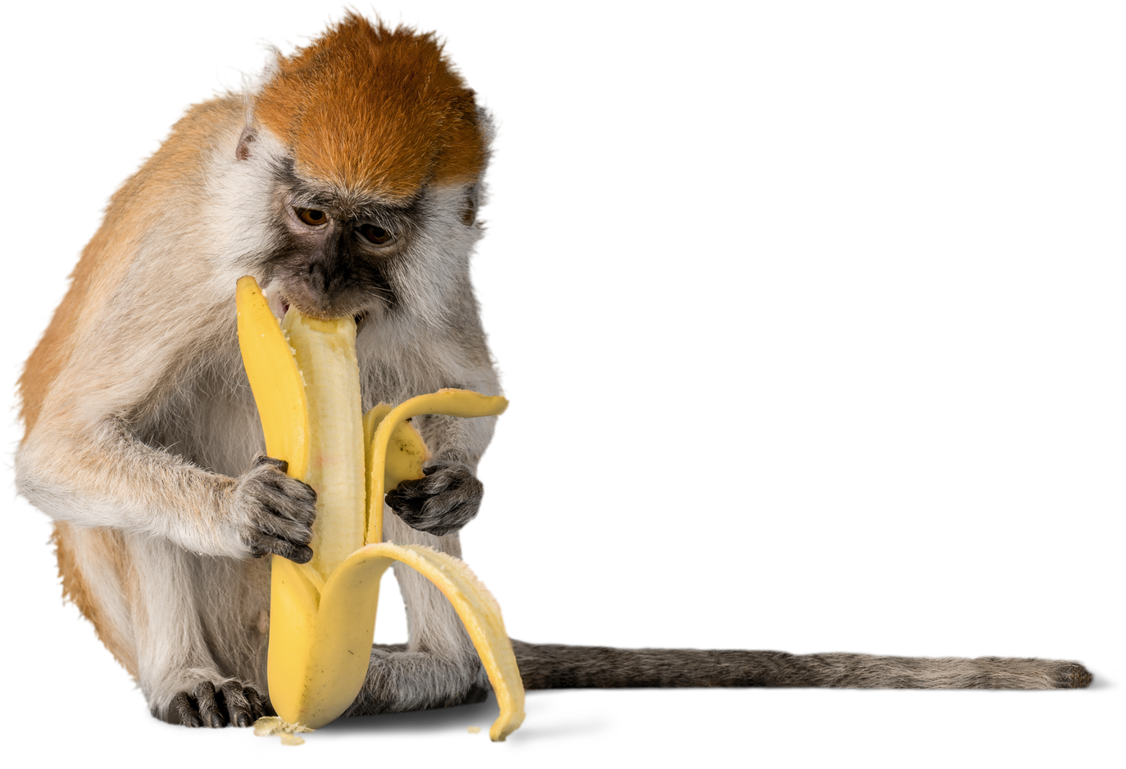
Scrolly
What did we learn?
We didn't just want to summarise study material.
We wanted to change how students “experience” it.
AI can turn ideas into products quickly.
Presentation affects how people learn.
Interactive learning keeps students engaged.
Quizzes and feedback make learning active.
Multiple languages improve accessibility.
AI content must be checked for accuracy.

